Slide 1
Watlab installation
Yuan-Hung Chiu
2025/11/23

Slide 2
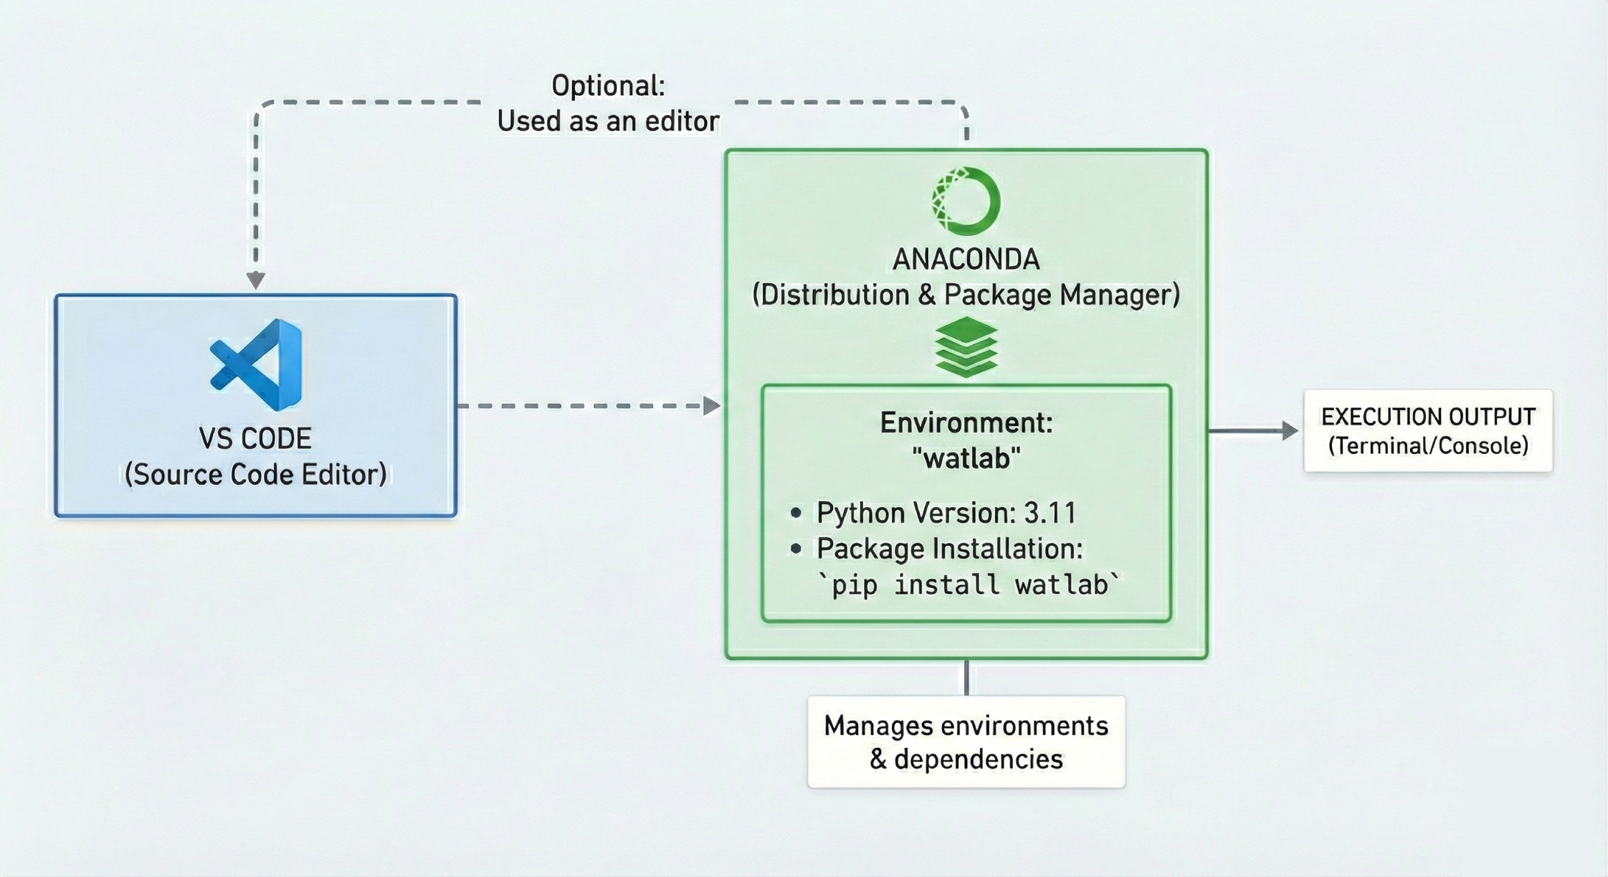
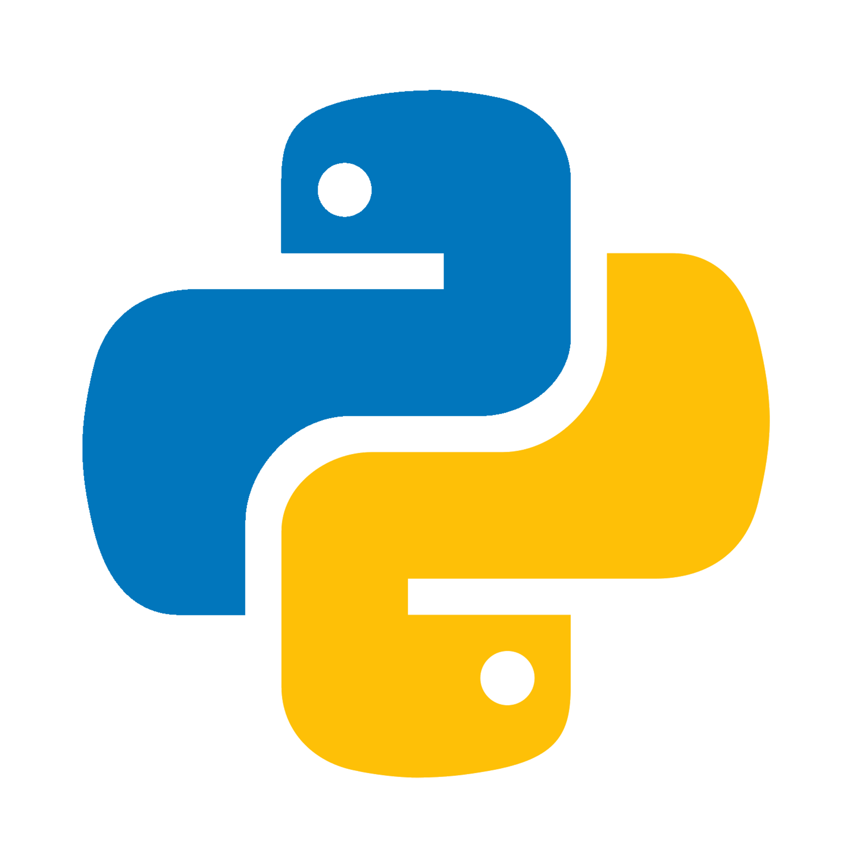

Slide 3
Contents
Install Anaconda
Install Visual Studio Code
Watlab environment setup
Run the first watlab code

Slide 4
Contents
Install Anaconda
Install Visual Studio Code
Watlab environment setup
Run the first watlab code

Slide 5
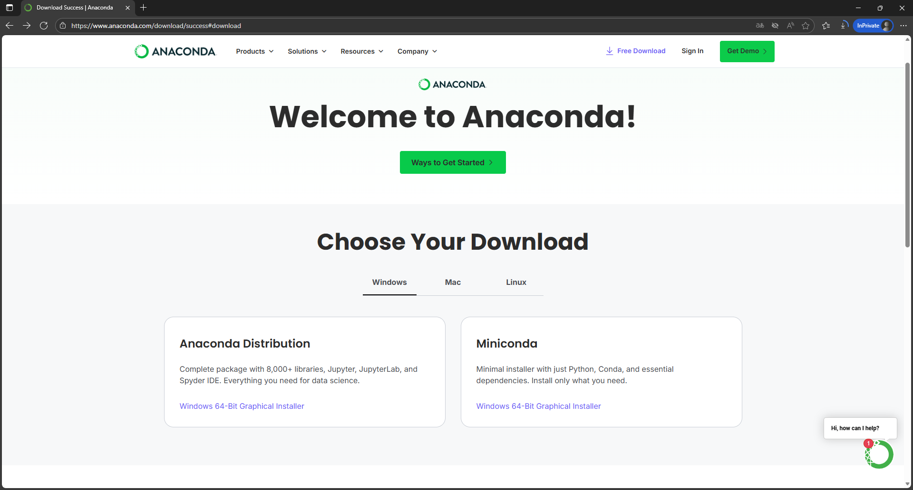
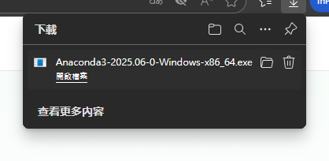
3.
1.
Download link: https://www.anaconda.com/download/success#download
2.

Slide 6
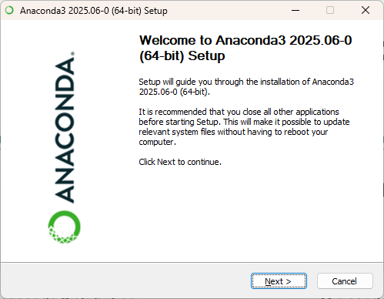

Slide 7
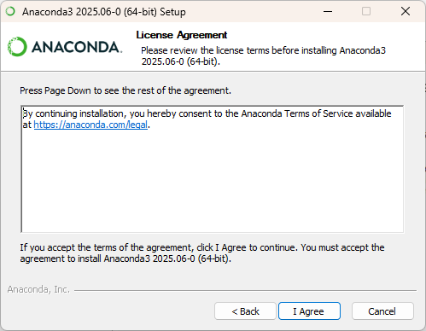

Slide 8
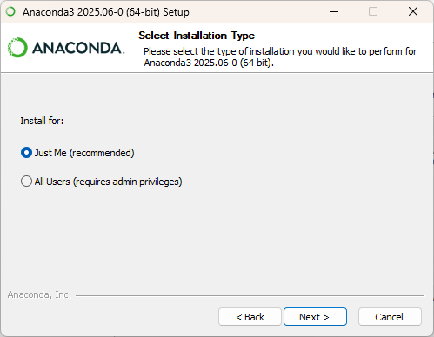

Slide 9
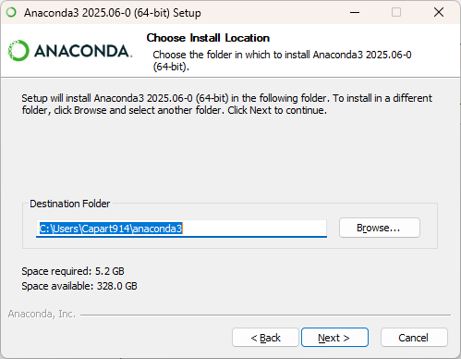

Slide 10
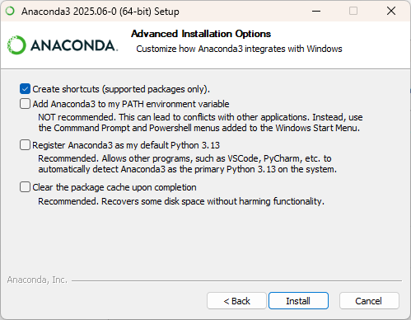

Slide 11
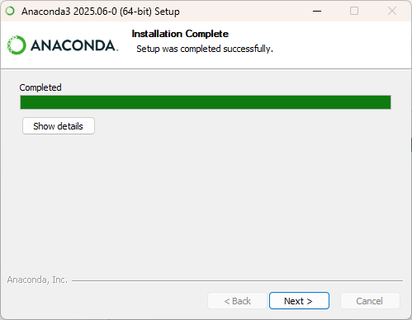

Slide 12
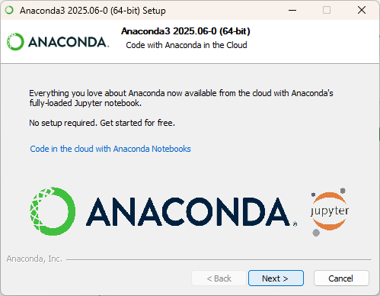

Slide 13
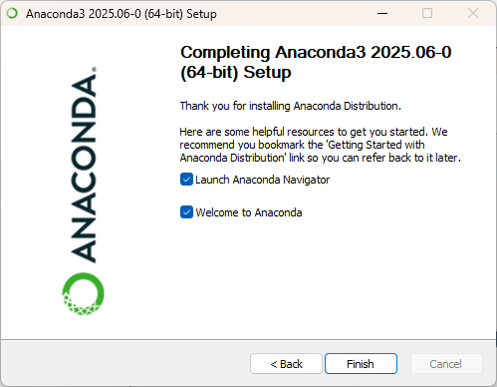

Slide 14
Contents
Install Anaconda
Install Visual Studio Code
Watlab environment setup
Run the first watlab code

Slide 15
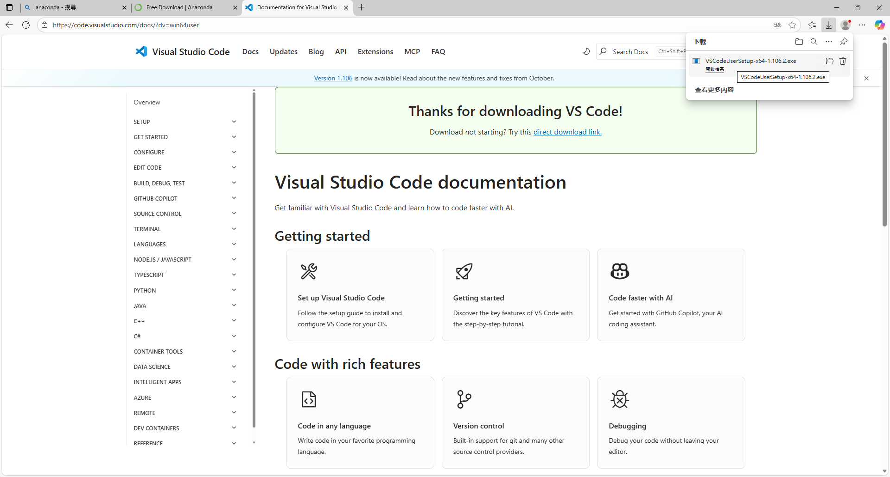

Slide 16
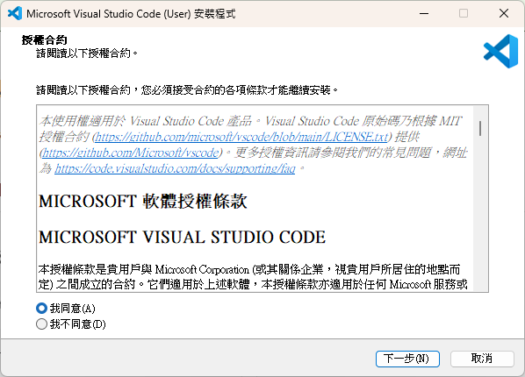

Slide 17
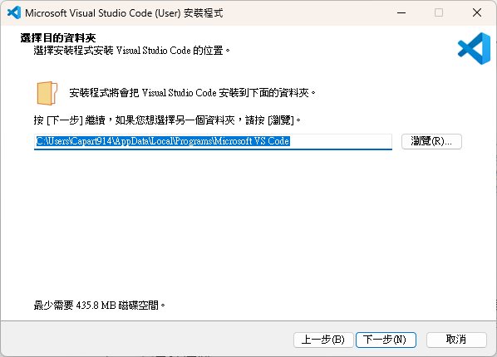

Slide 18
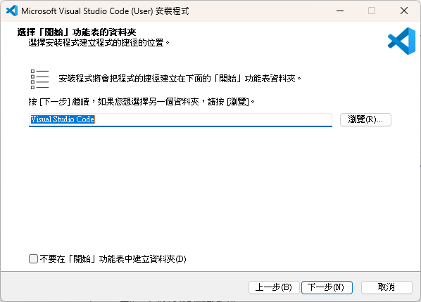

Slide 19
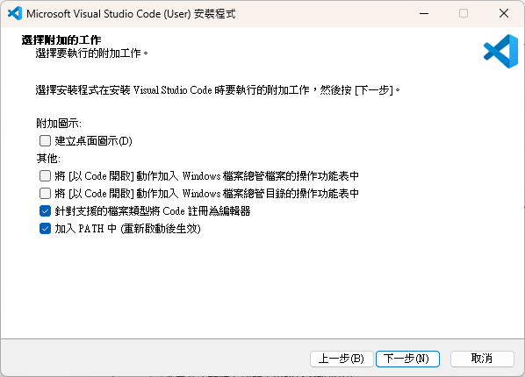

Slide 20
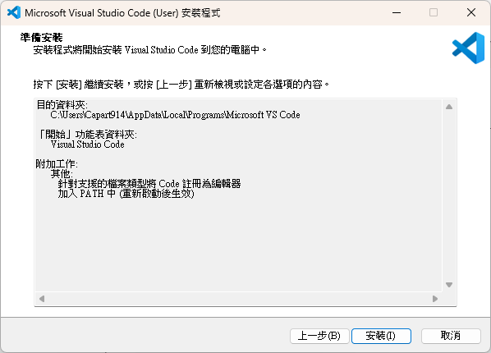

Slide 21
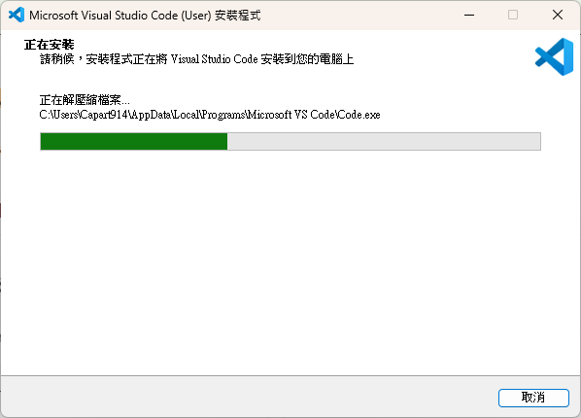

Slide 22
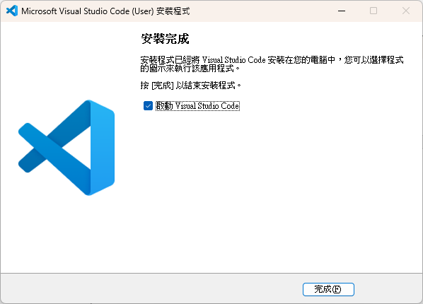

Slide 23
Contents
Install Anaconda
Install Visual Studio Code
Watlab environment setup
Run the first watlab code

Slide 24
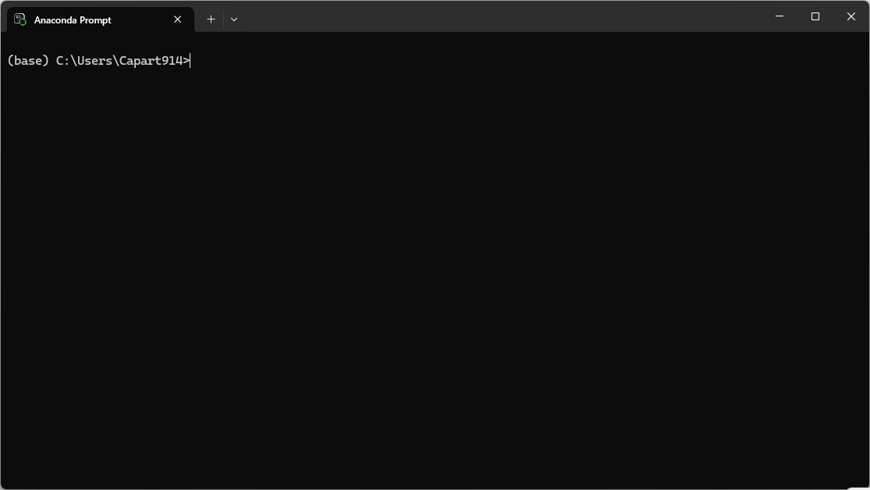
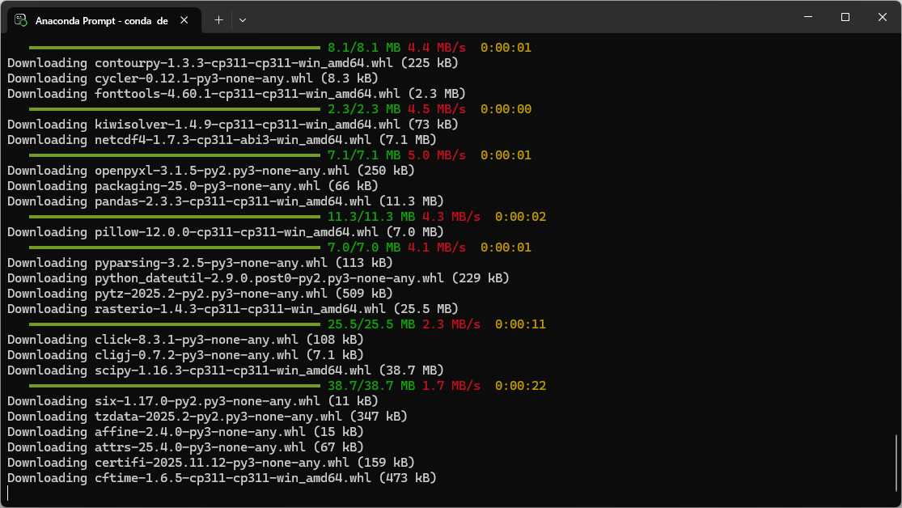
Create Watlab environment in Anaconda
1. Open Anaconda Prompt
2. Type the following commands in the Anaconda
Prompt. Press [y] whenever it asks you to
confirm the installation.
conda create --name watlab python=3.11
conda activate watlab
python -m pip install watlab
python -m pip install seamsh
Please wait until it finish…..

Slide 25
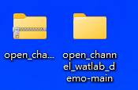
Install GDAL
1. The link for Watlab installation instruction and today’s demo scripts:
https://github.com/damiel-hub/open_channel_watlab_demo
2. Please un-zip the folder first.
3. Navigate to the directory “open_channel_watlab_demo-main\environment_setup” using the cd command in
Anaconda Prompt.
Note: If the folder is on a different drive (e.g., D:), switch to that drive first by typing the drive letter followed by a
colon (:).
4. Type the following commands in the Anaconda Prompt.
cd to_your_path\open_channel_watlab_demo-main\environment_setup
python -m pip install GDAL-3.4.3-cp311-cp311-win_amd64.whl

Slide 26
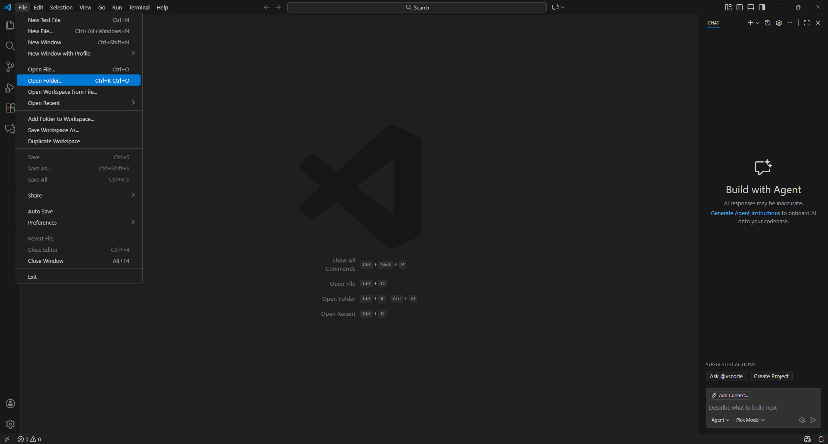
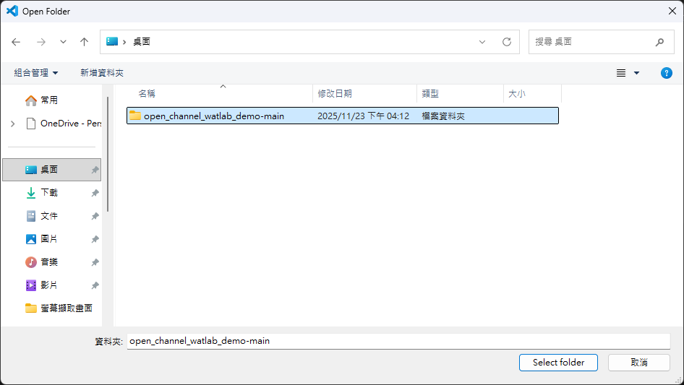
1.
2.
3.
4.
Open the demo folder in VS code (1/2)

Slide 27
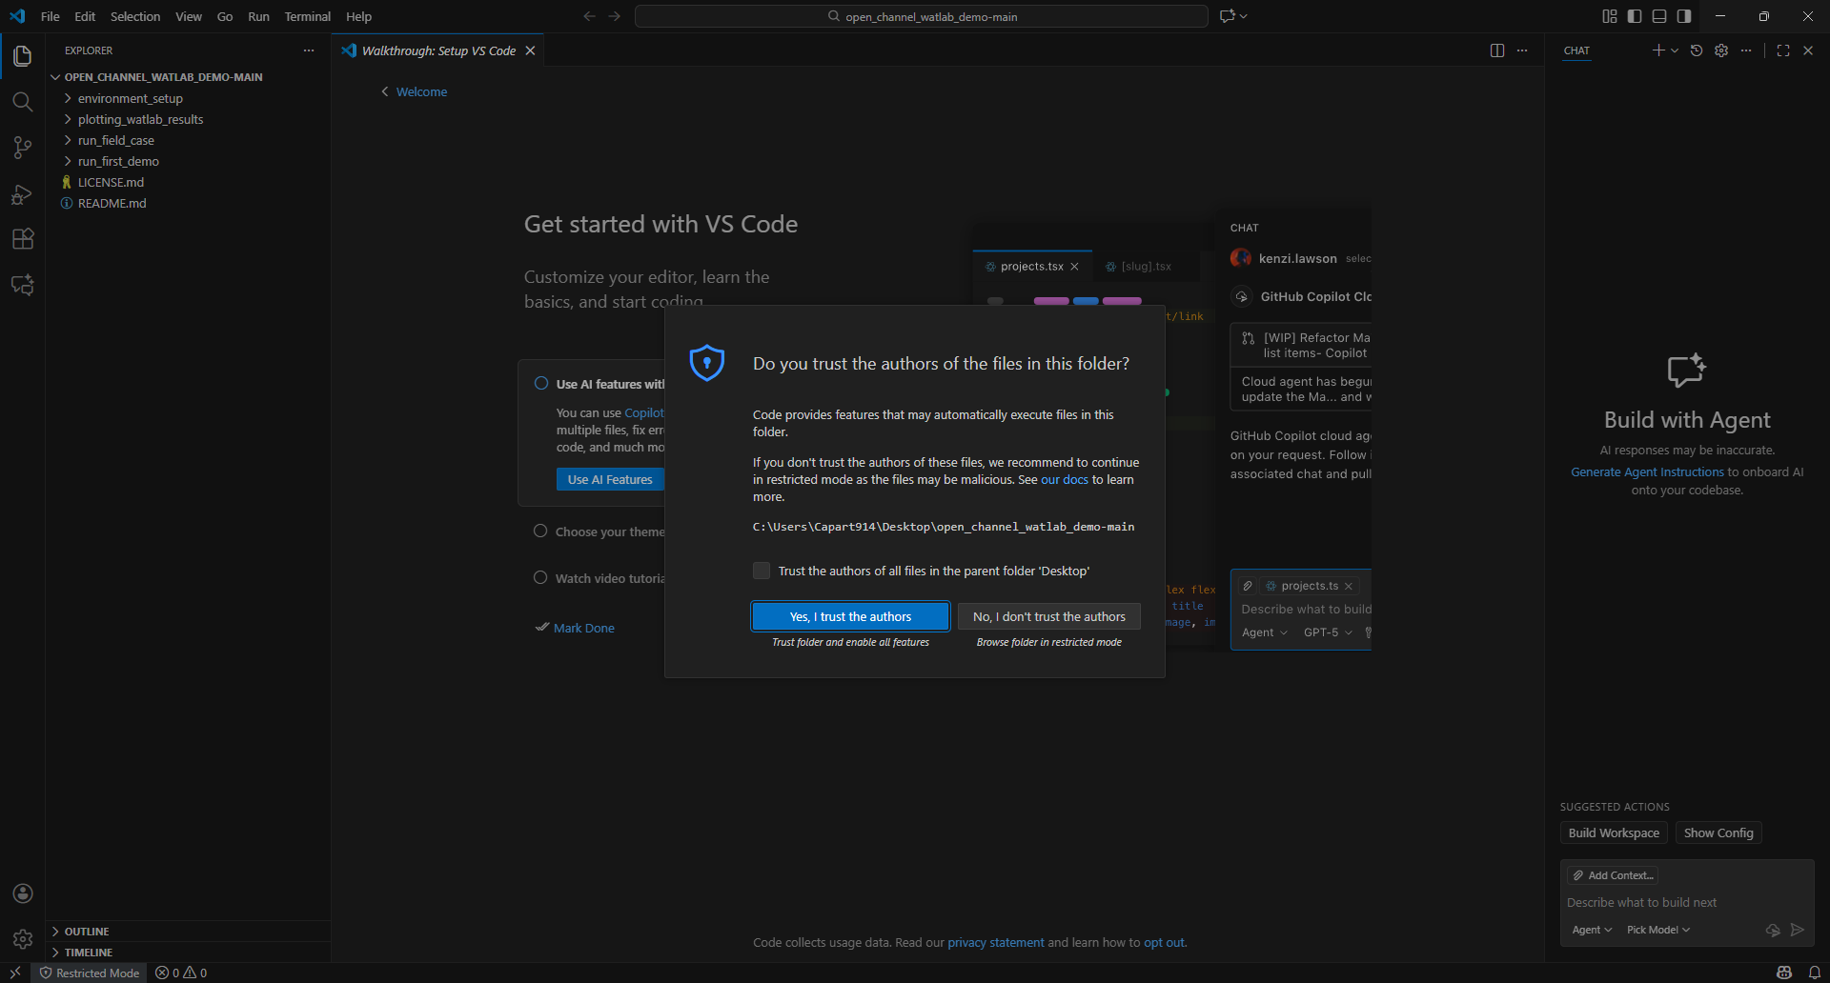
Open the demo folder in VS code (2/2)

Slide 28
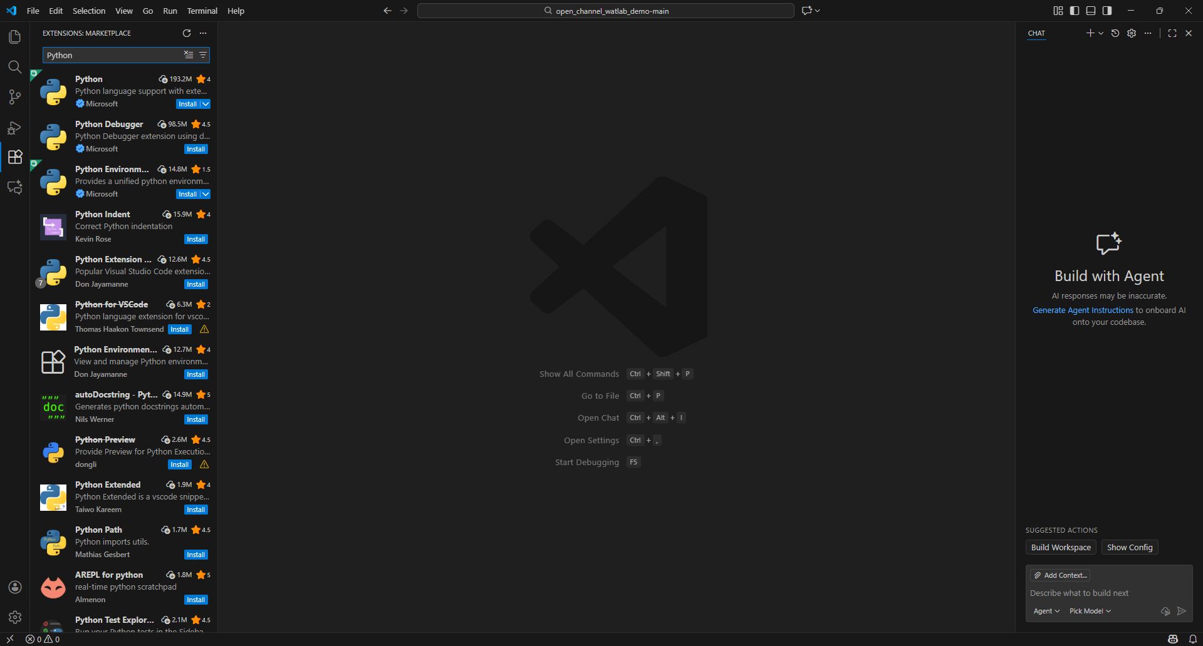
2. Search Python
3. Click install
1.
Connent Python in Watlab env to VS code (1/2)

Slide 29
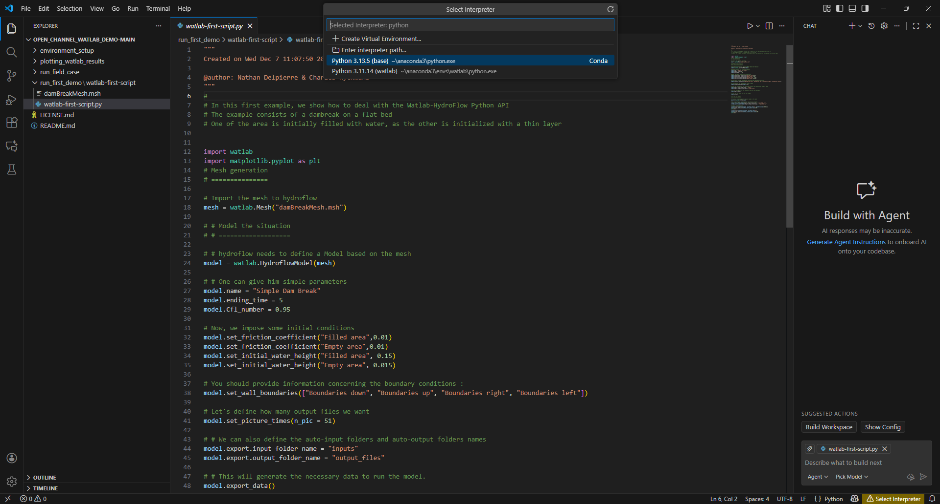
2. Select the python in the watlab environment
If you can not find “Select Interpreter” button, please press “ctrl+shift+P” and type the command “Python: Select Interpreter” to select the environment.
Connent Python in Watlab env to VS code (2/2)
1.

Slide 30
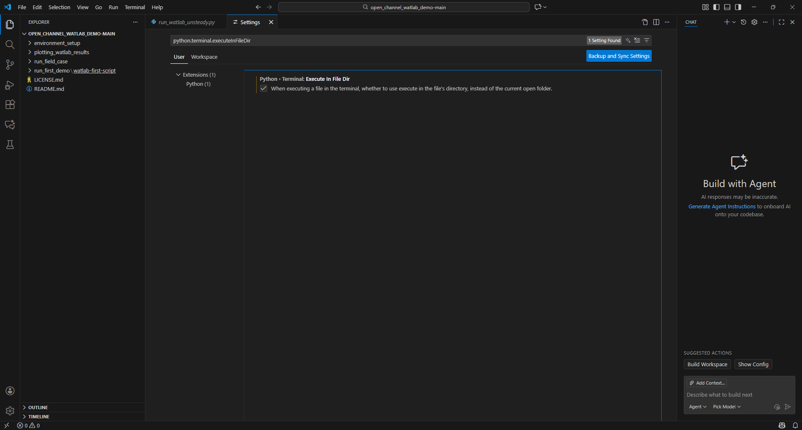
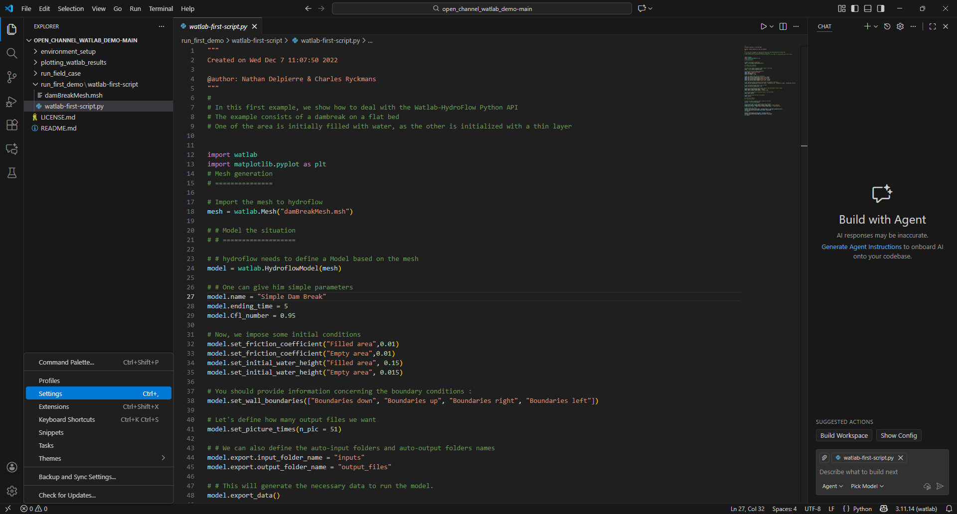
3. Search: “python.terminal.executeInFileDir”
4. Check this box
2.
Execute in the File direction
1.

Slide 31
Contents
Install Anaconda
Install Visual Studio Code
Watlab environment setup
Run the first watlab code

Slide 32
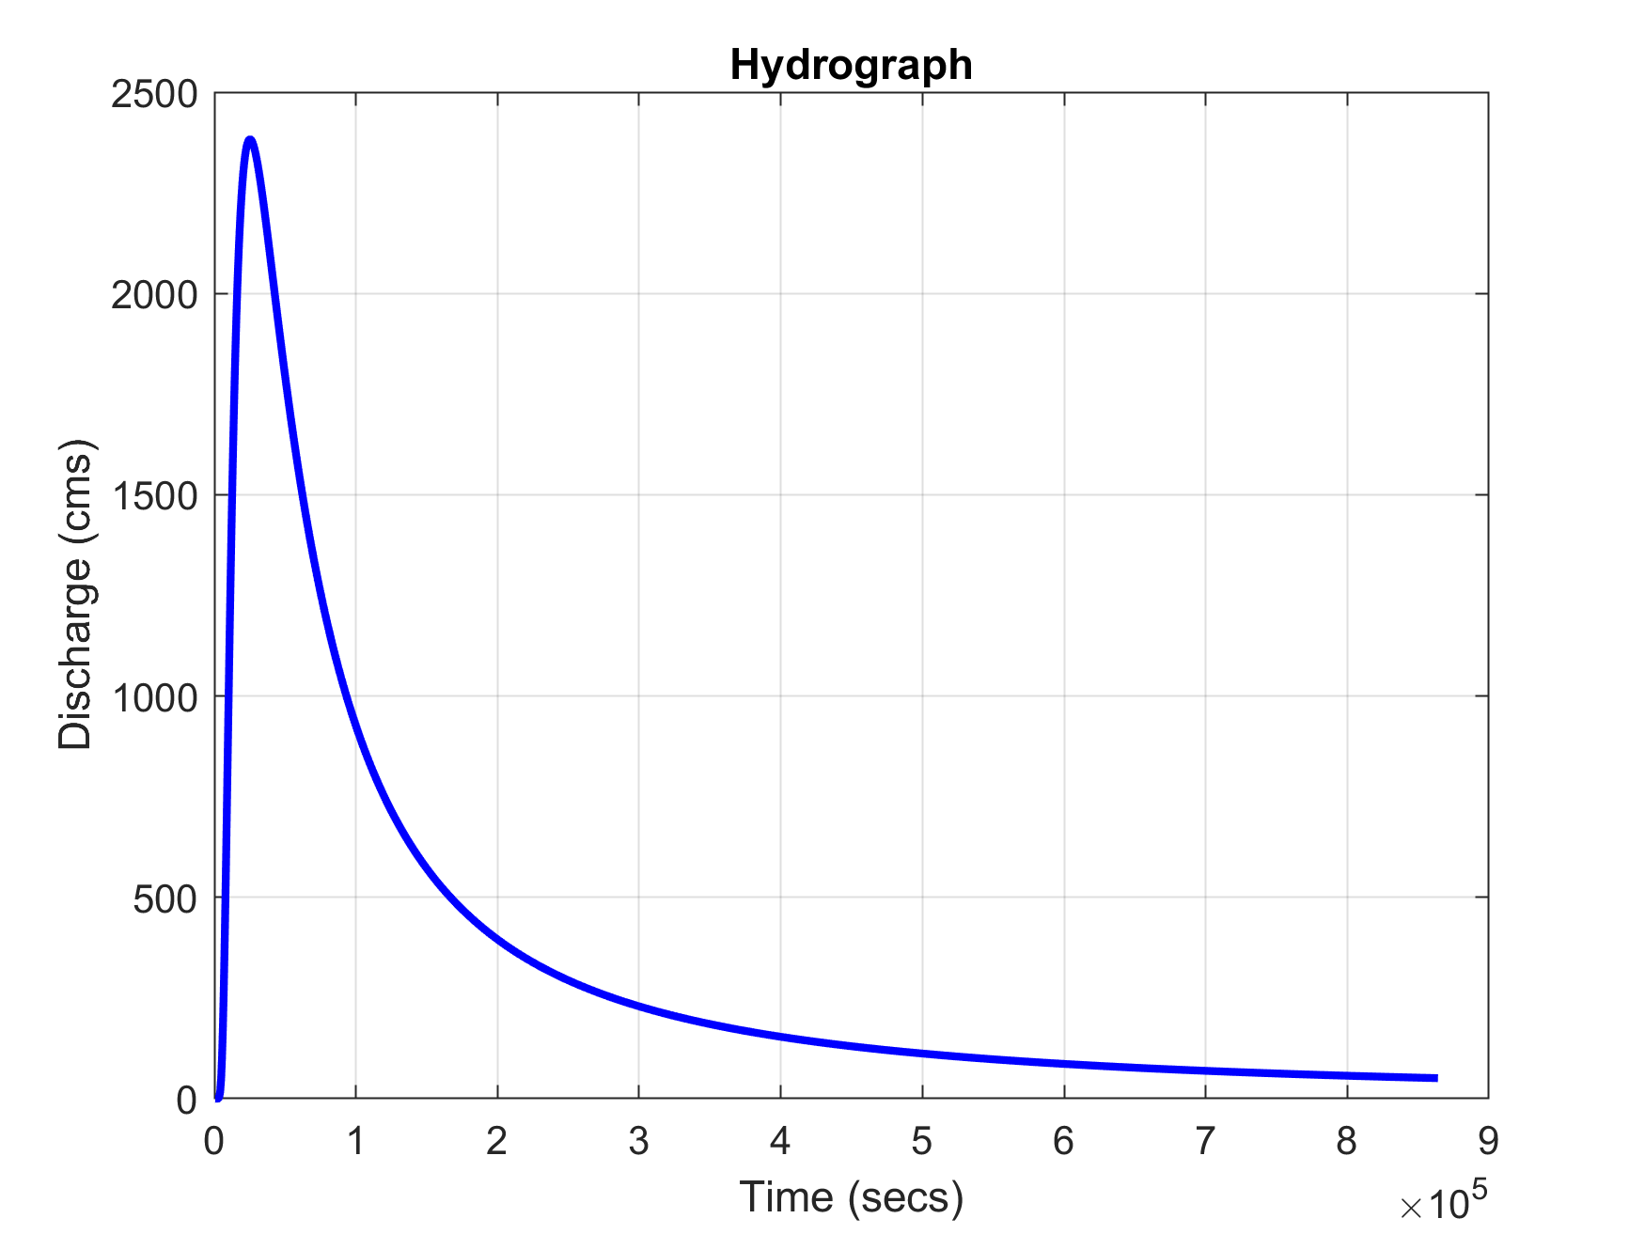
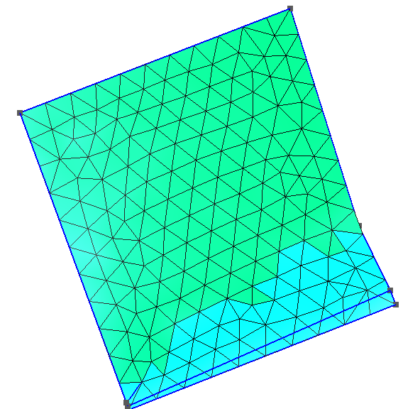
What is inside Watlab?
1. Pre-processing (Handle by Python):
watlab : reading the mesh (.msh file).
hydroflow : assigning properties like friction coefficients and boundary conditions, and translating them to the text file that C++ can understand.
2. Solving (Handle by C++)
It reads the simple text files generated by Python, runs the Finite Volume Method algorithms, and exports results to text files.
3. Post-processing (Handle by Python)
Pre-processing (Python)
Solving (C++)
Manning n
input
output
Watlab
(user interface)
hydroflow
(translator)
hydroflow-win.exe
(HLL solver)
.txt
.txt
hydrograph
mesh

Slide 33
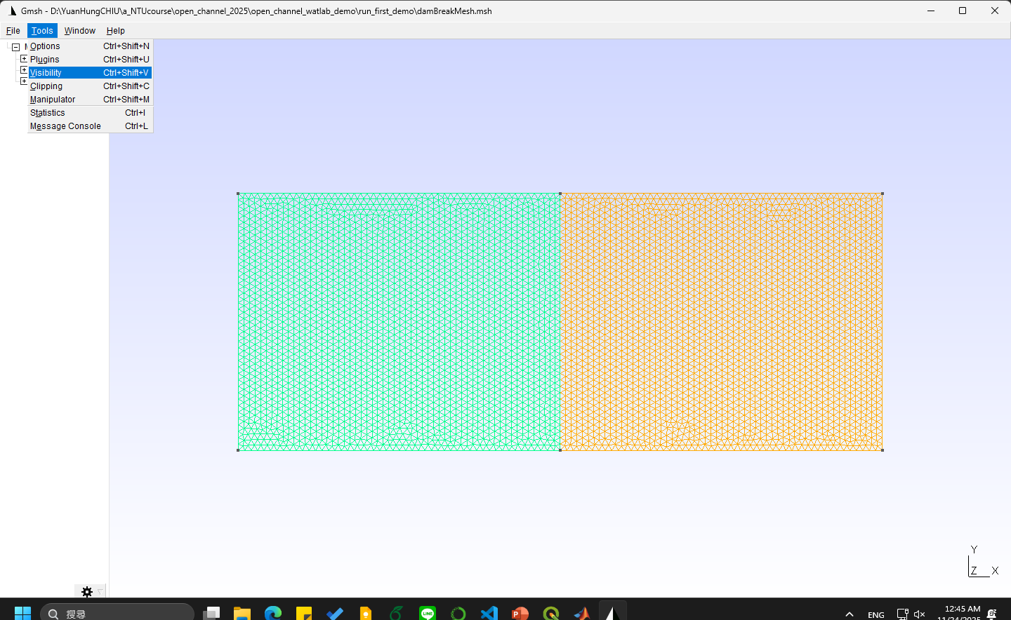
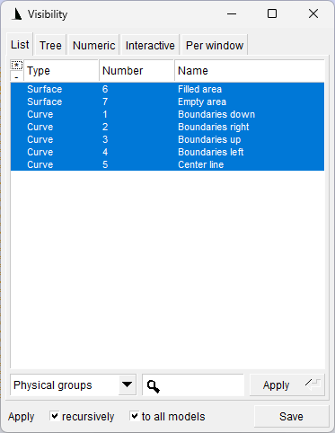

Download gmsh to open and check .msh files: https://gmsh.info/

Slide 34
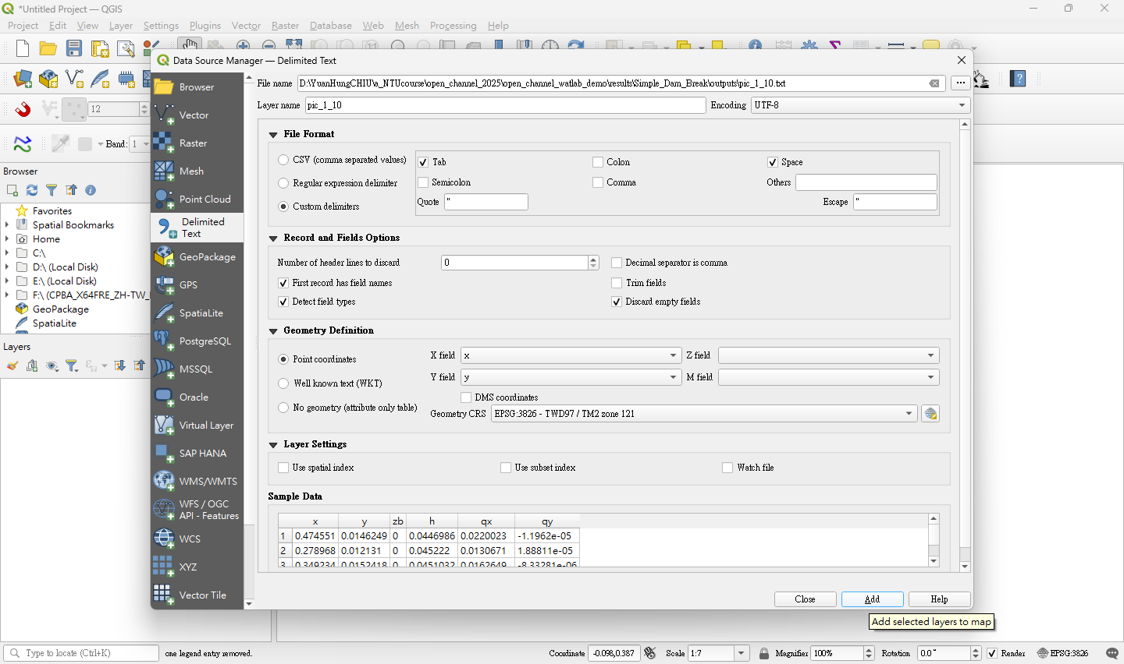
1. Give a pic_xx_xx.txt file.
2. Verify that the boxes match the ones shown here.
Post-processing in QGIS (1/3)

Slide 35
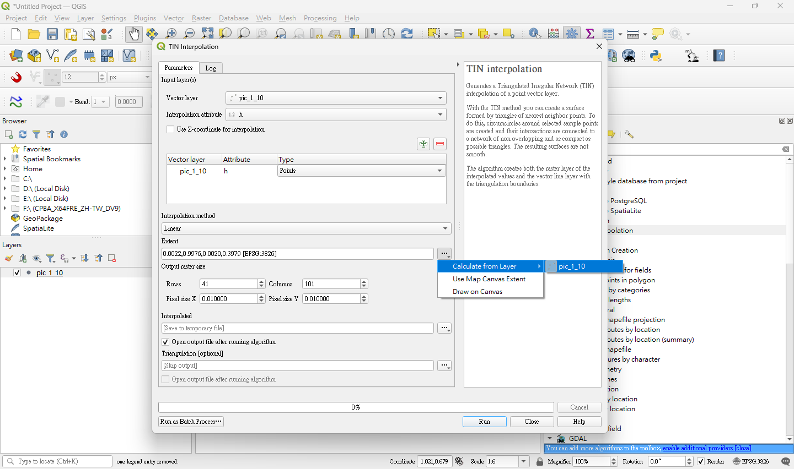
2. Select the points layer
3. Choose a variable
1. Search “TIN interpolation” in the toolbox.
4. Click here
5. Use points extent as raster extent
6. Give the raster resolution
7. Run !
Post-processing in QGIS (2/3)

Slide 36
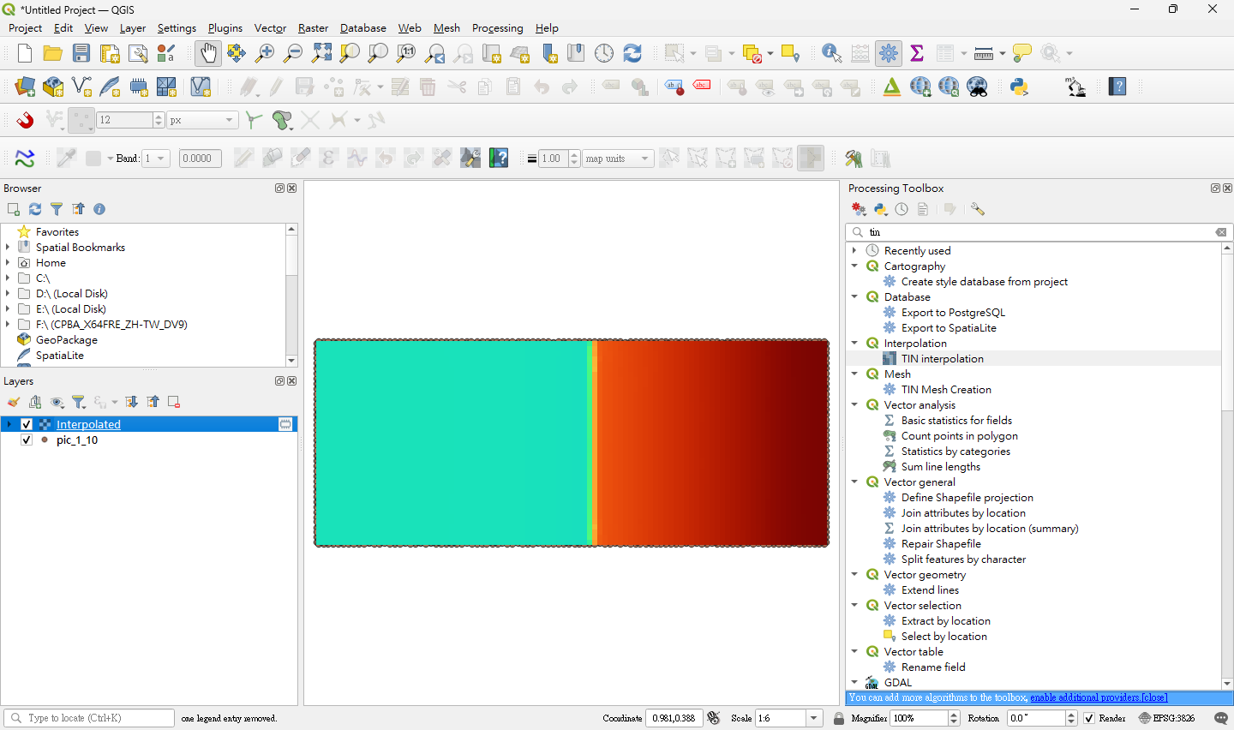
Post-processing in QGIS (3/3)

